Slide 1


Unit 4: Culture spot
Hollywood
U ovoj ćemo lekciji:
koristiti present simple za izražavanje općenitih istina
govoriti o vrstama filmova i o slavnim osobama
čitati o Hollywoodu i govoriti o industriji filma

Slide 2


Slide 3
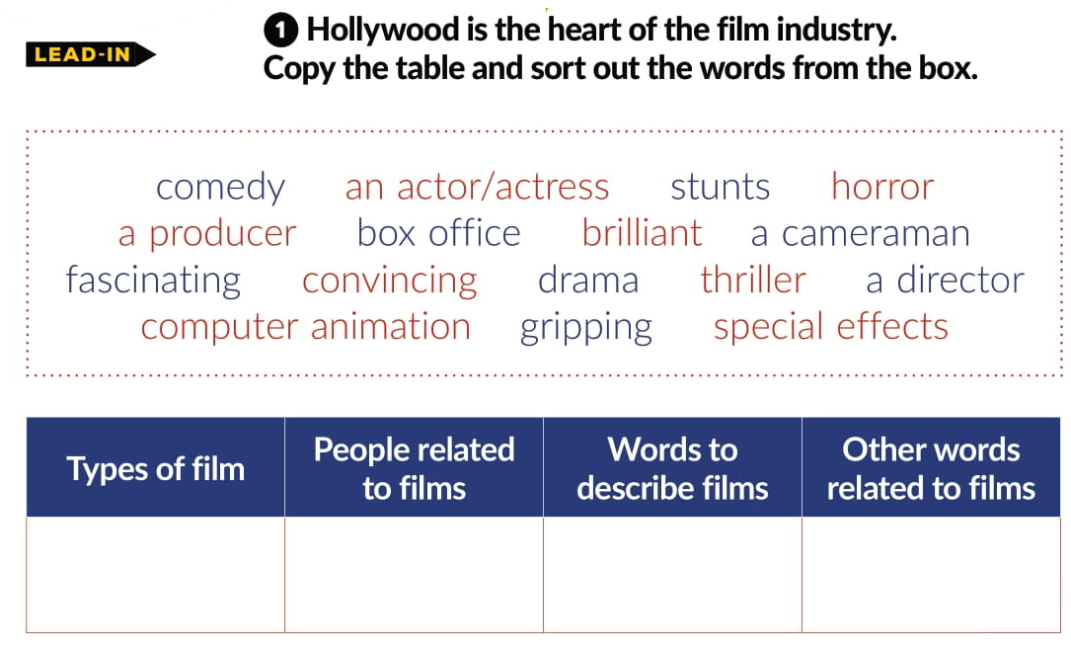
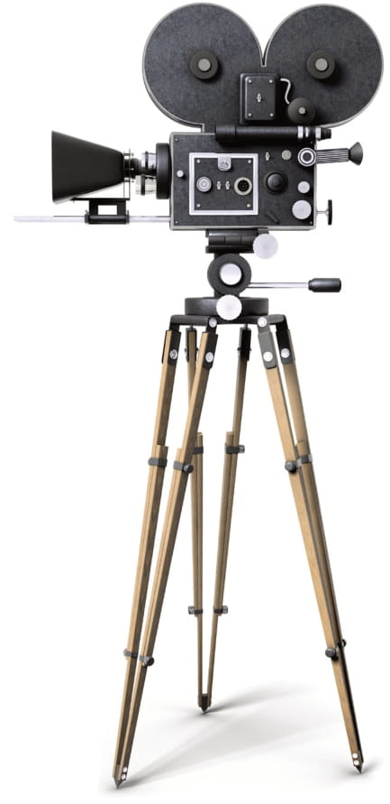
comedy
an actor/actress
brilliant
stunts
horror
a producer
fascinating
computer animation
drama
a cameraman
convincing
special effects
thriller
a director
gripping

Slide 4
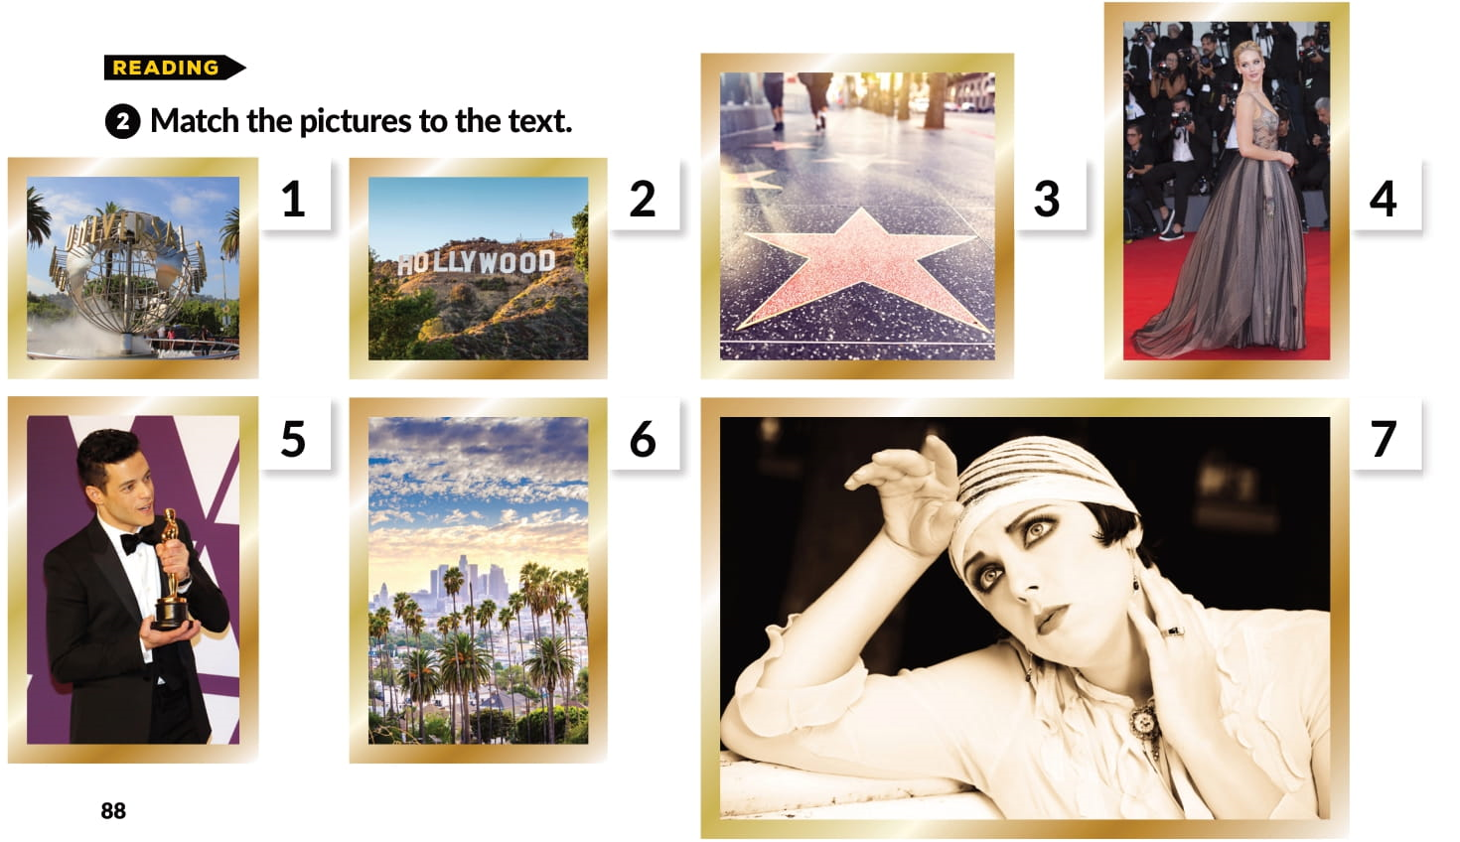

Slide 5
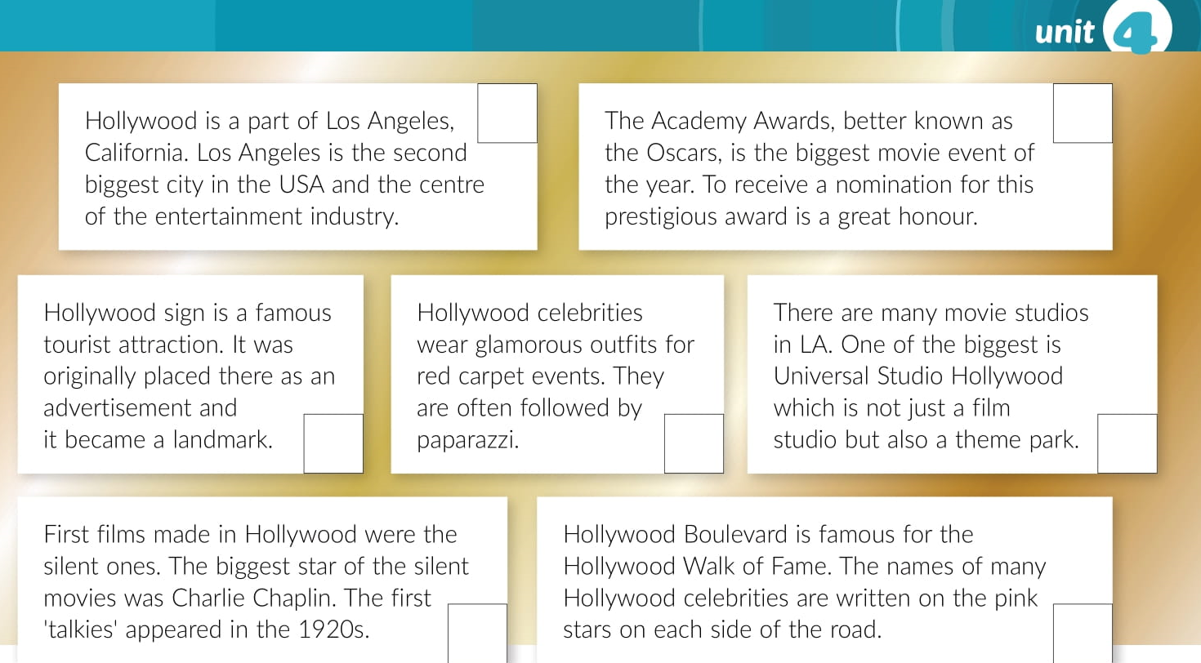
6
5
2
4
1
7
3

Slide 6
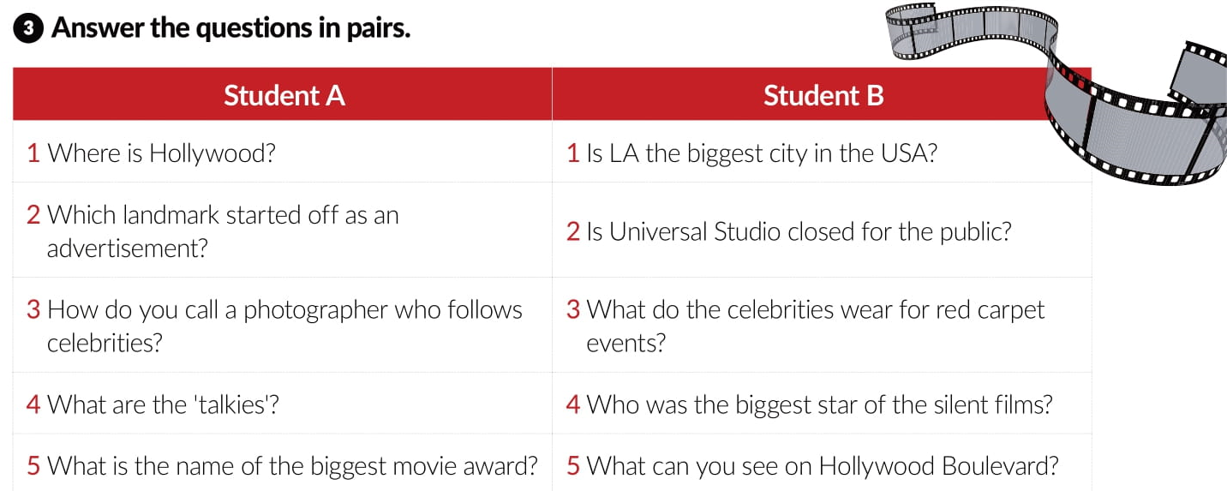

Slide 7
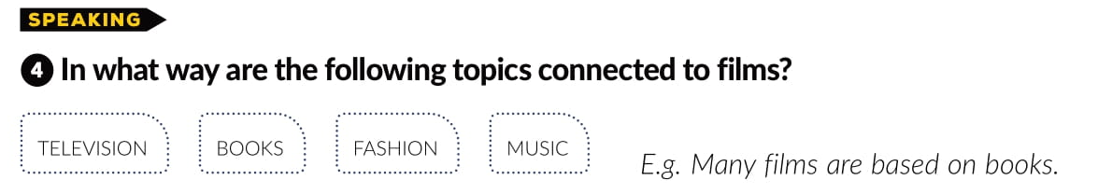

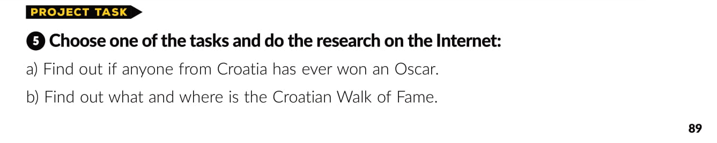

Slide 8
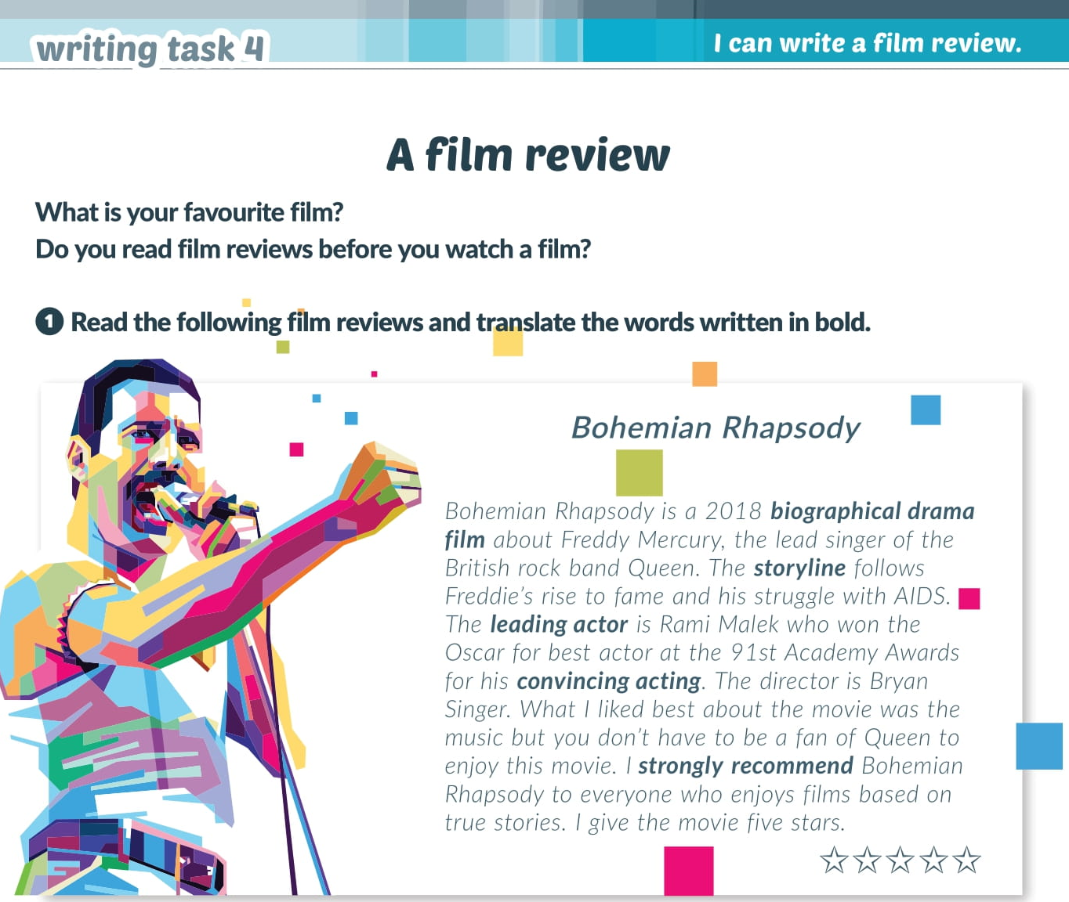

Slide 9


Slide 10
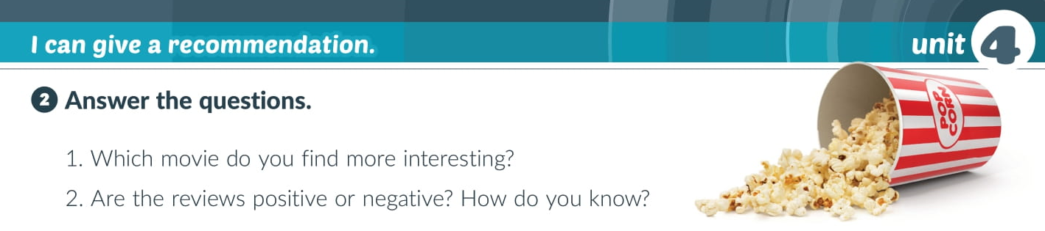
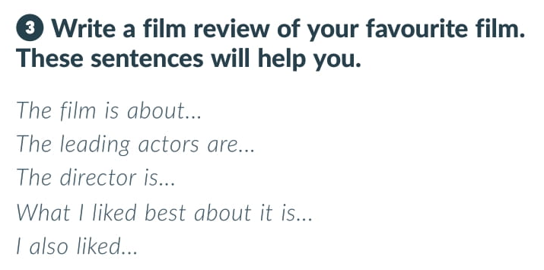
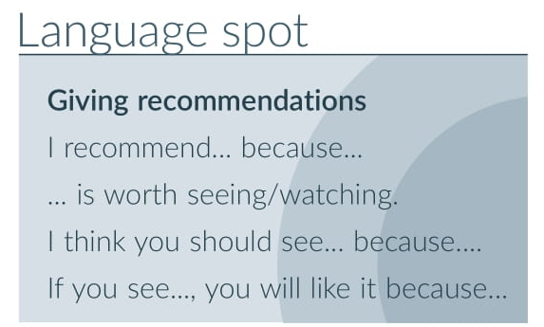

Slide 11
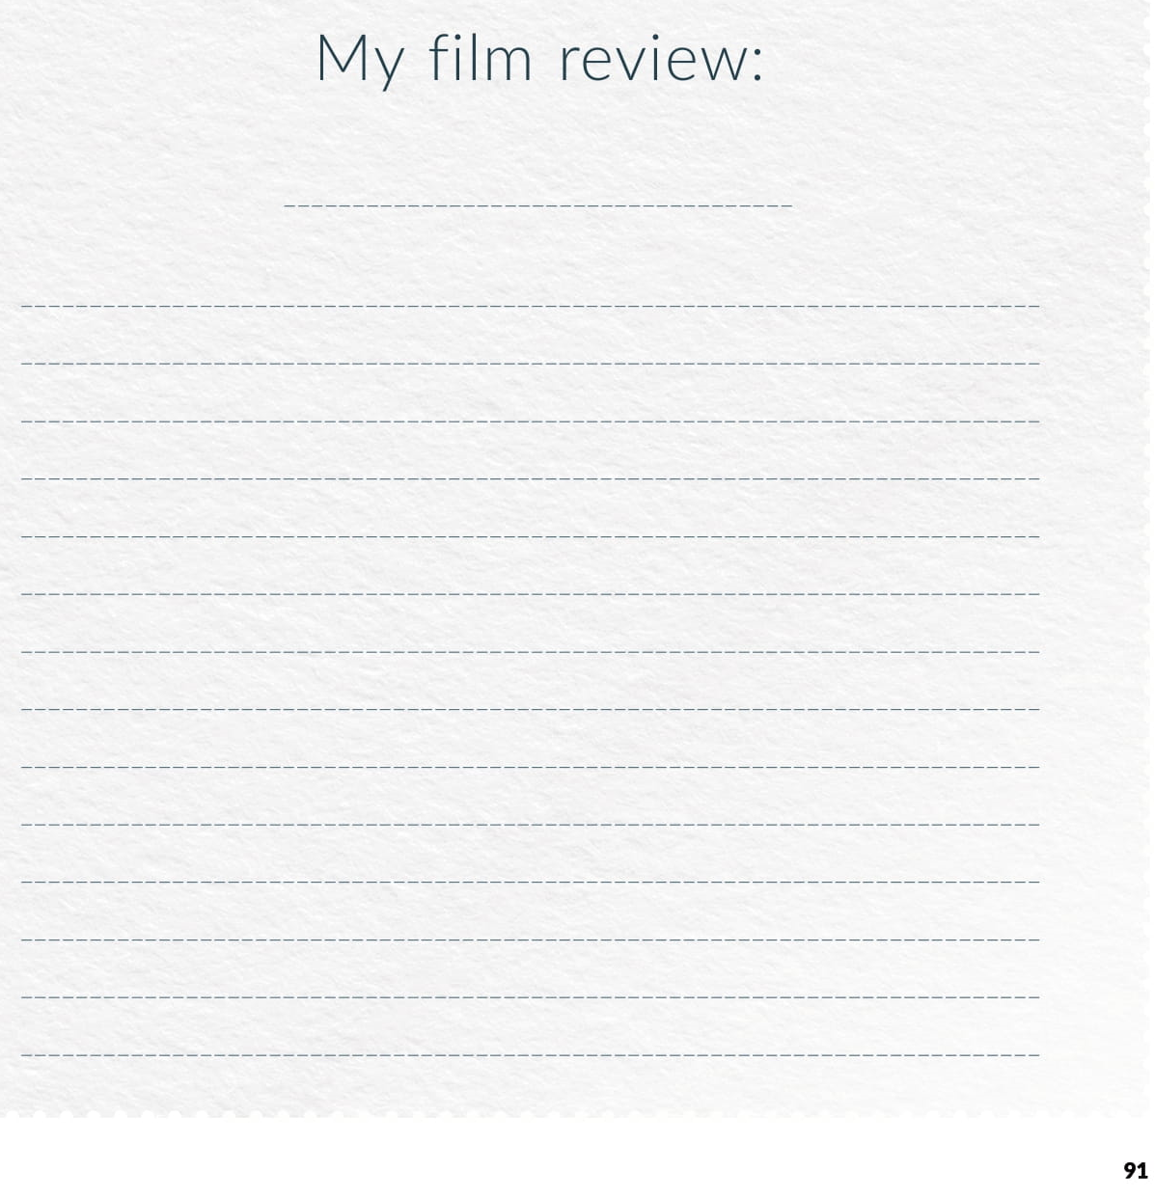

Slide 12


Slide 13
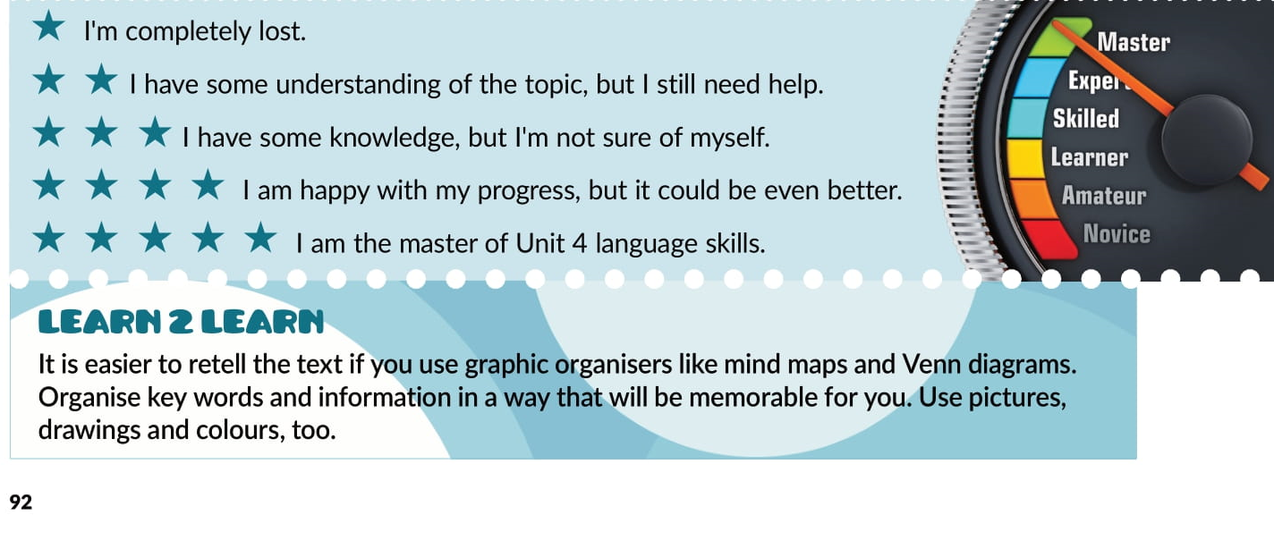

Slide 14

PLAY AND LEARN!
Culture spot 4 | Way to go 4 (e-sfera.hr)

